Slide 1
Multi-Scale Contrastive Siamese Networks for Self-Supervised Graph Representation Learning
IJCAI 2021
Code: github.com/GRAND-Lab/MERIT
2021.09.05 • ChongQing
Reported by Chenghong Li

Slide 2
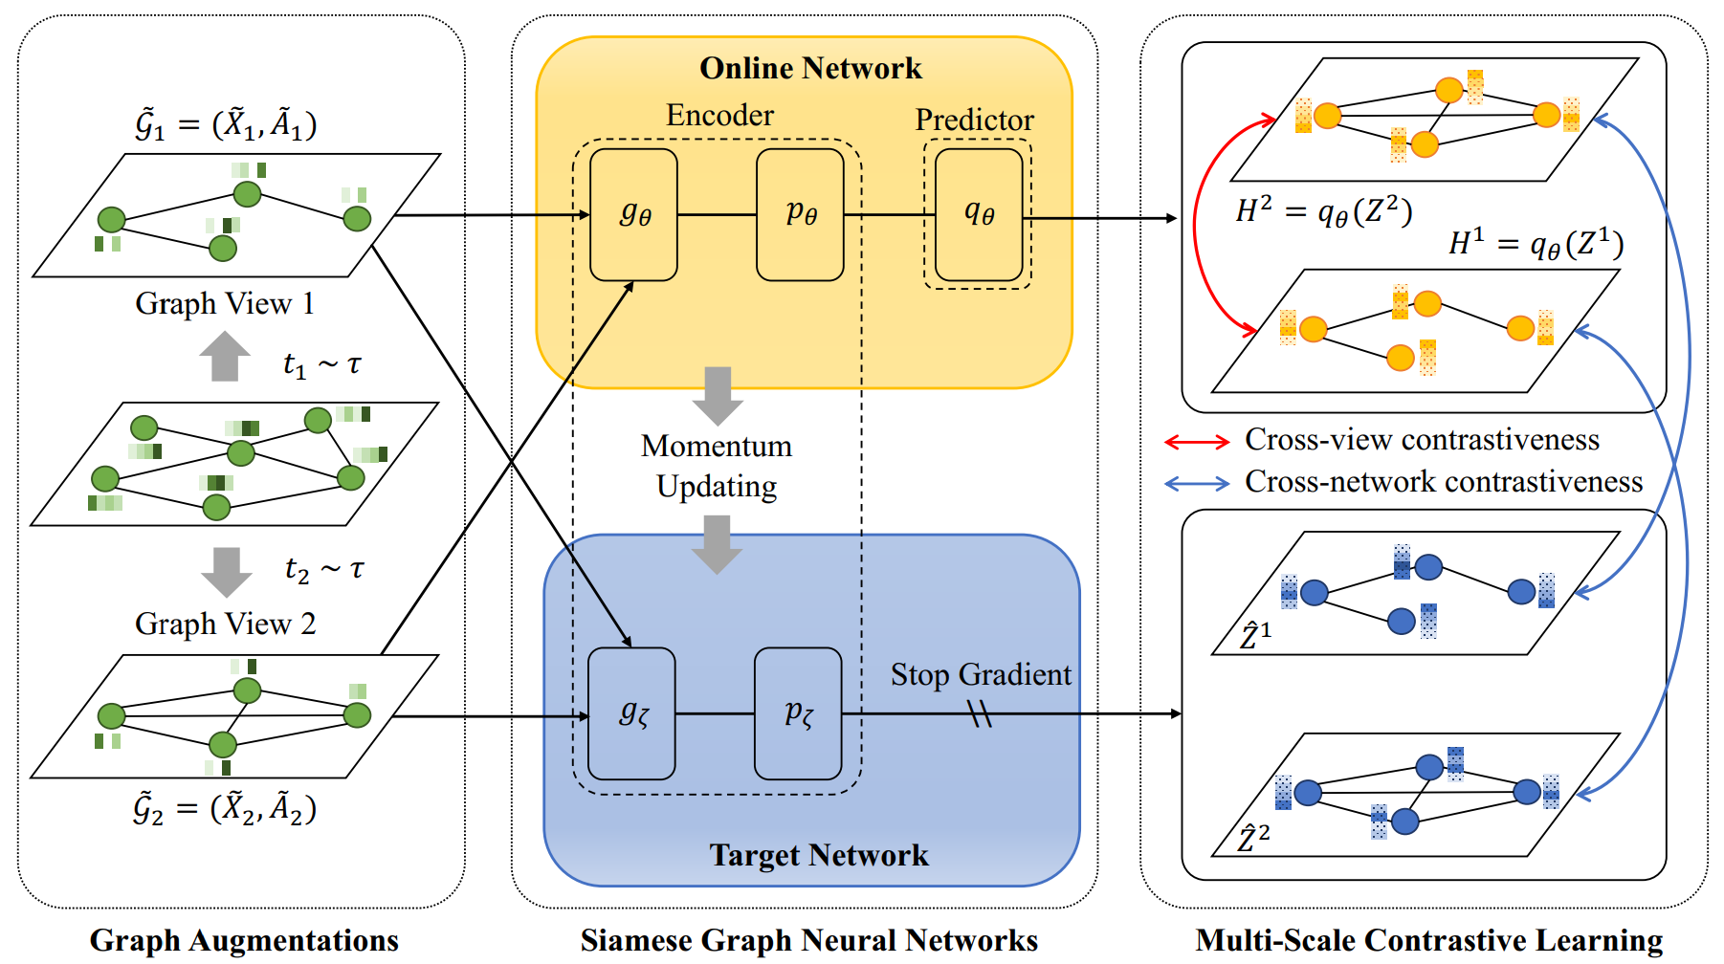
Introduction

Slide 3
Method

Slide 4
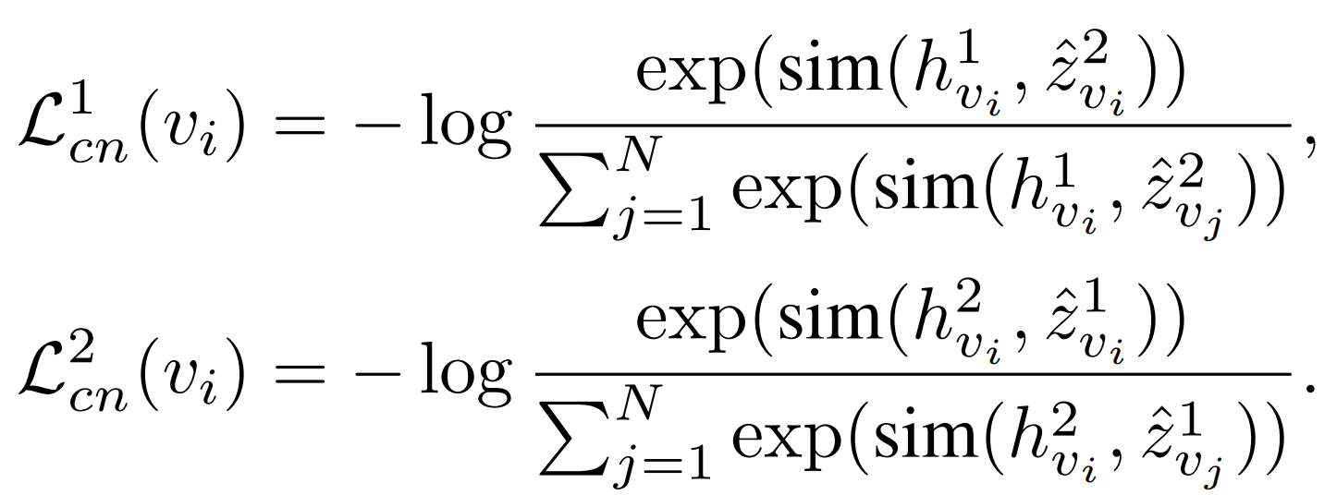
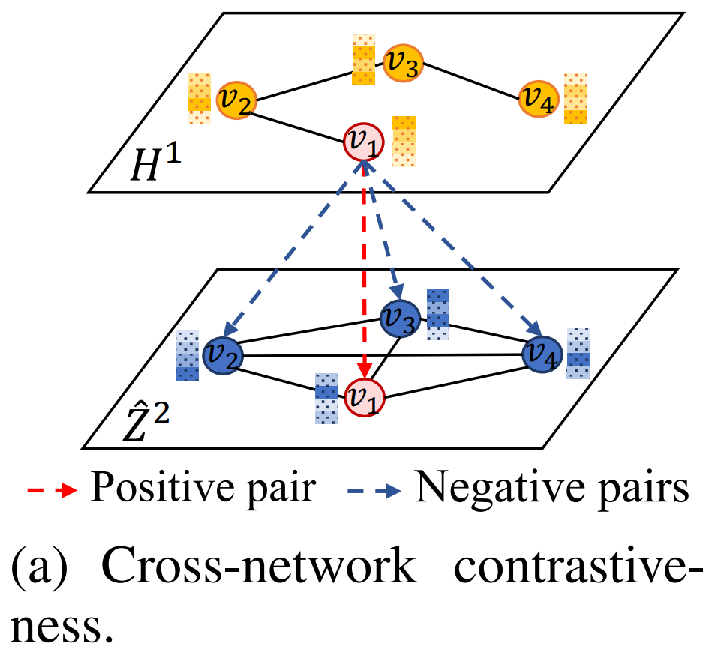
Method

Slide 5
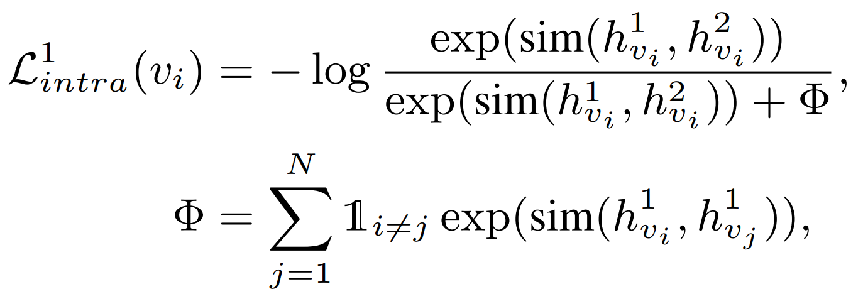
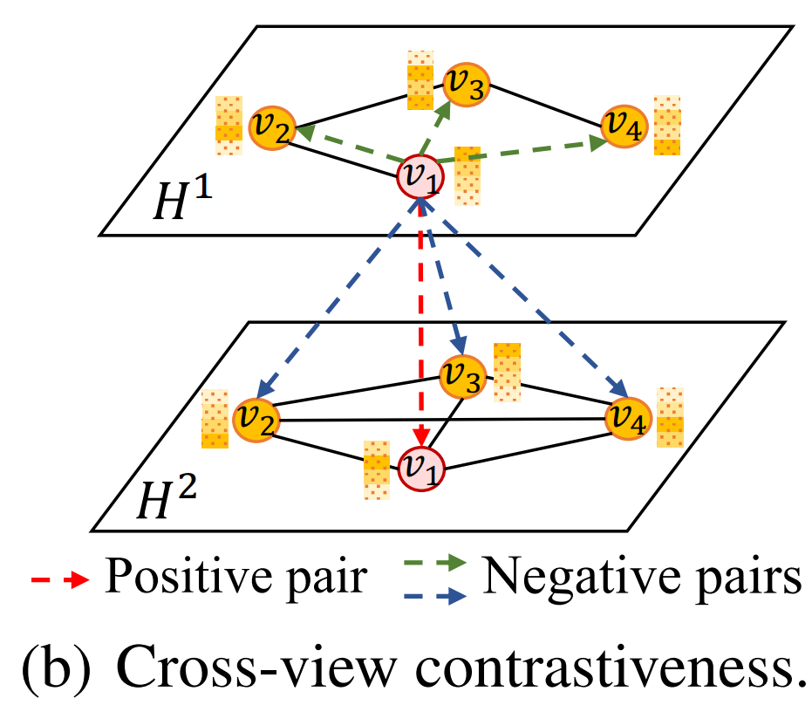
Method

Slide 6
Method

Slide 7
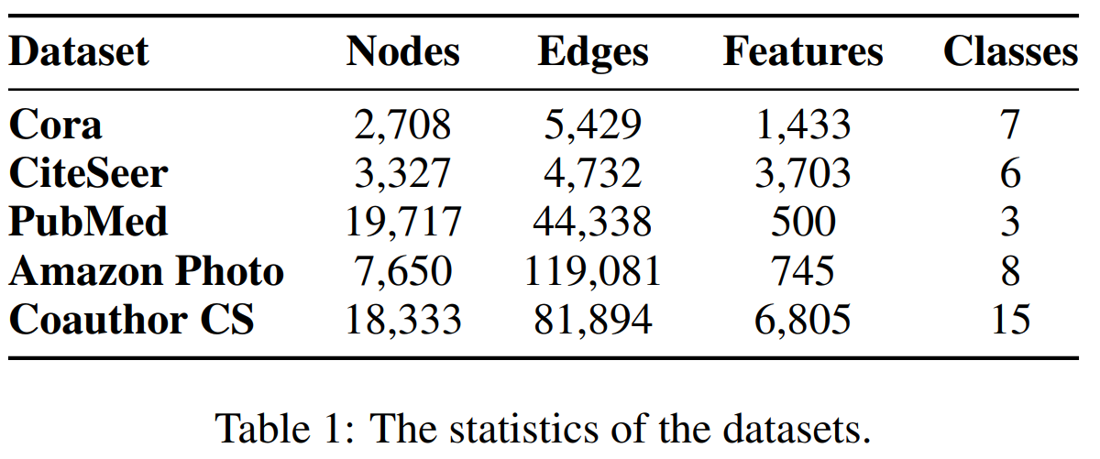
Experiments

Slide 8
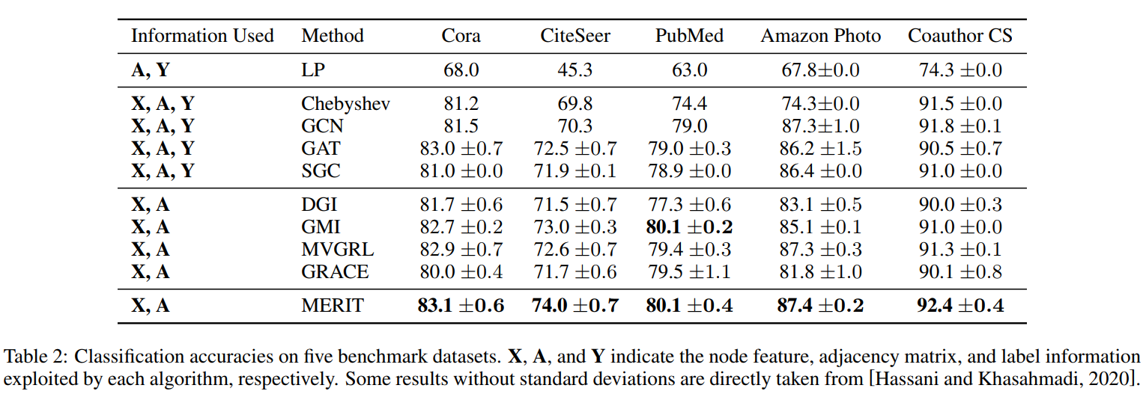
Experiments

Slide 9
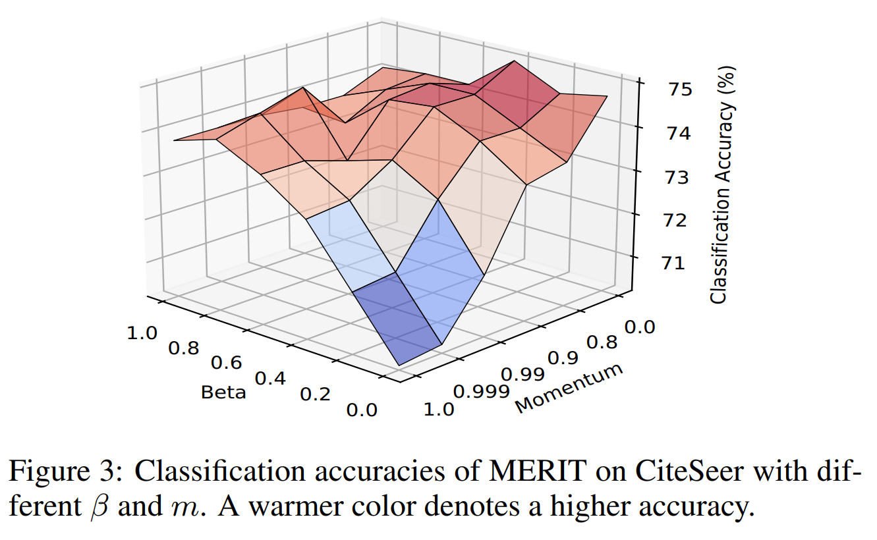
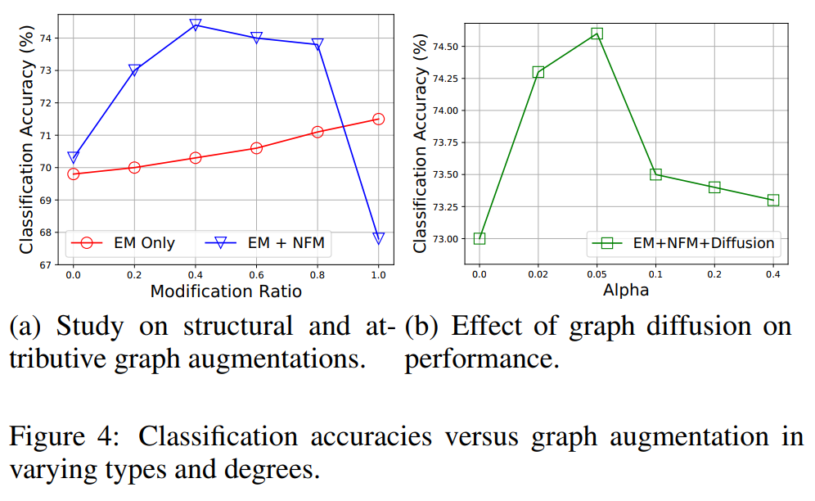
Experiments

Slide 10
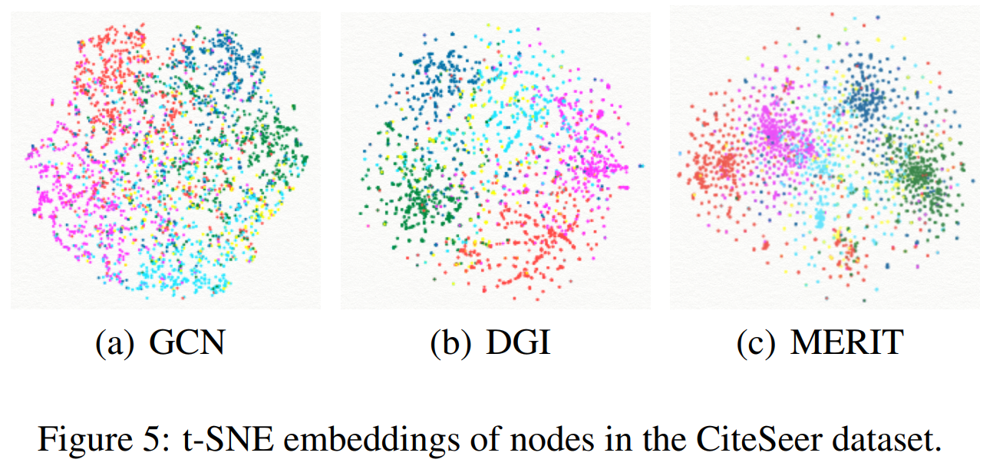
Experiments

Slide 11
Thanks

